Slide 1
Project Evaluation Phase 1
Dog Vision : Identify Any Breed
- Namish Rathy , Aryan Manchanda , Manan Sharma

Slide 2
Idea
Dog Vision is a statistical machine learning project designed to accurately identify various dog breeds from images. Utilizing the versatile programming language Python and libraries like TensorFlow and PyTorch, Dog Vision leverages advanced machine learning algorithms to analyze visual features in dog images. The project incorporates image processing techniques using OpenCV and data manipulation with Pandas, ensuring a robust dataset sourced from platforms like Kaggle. With tools for visualization like Matplotlib and Seaborn, Dog Vision provides intuitive insights into breed classifications. This innovative tool aims to assist pet adoption centers, veterinary clinics, dog training programs, and research organizations in promoting responsible pet ownership and understanding canine diversity

Slide 3
Application Area
Pet Adoption Centers: Help shelters and adoption agencies identify dog breeds for potential adopters, ensuring they match the right dog with the right home based on breed characteristics.
Veterinary Clinics: Assist veterinarians in quickly identifying breeds during examinations, enabling tailored healthcare recommendations and treatments specific to breed-related health issues.
Dog Training Programs: Aid trainers in understanding a dog's breed traits and behaviors, allowing for customized training approaches that cater to the specific needs of different breeds.
Research and Conservation: Support researchers and conservationists in studying breed diversity, genetics, and population dynamics, contributing to efforts in breed preservation and responsible breeding practices.

Slide 4
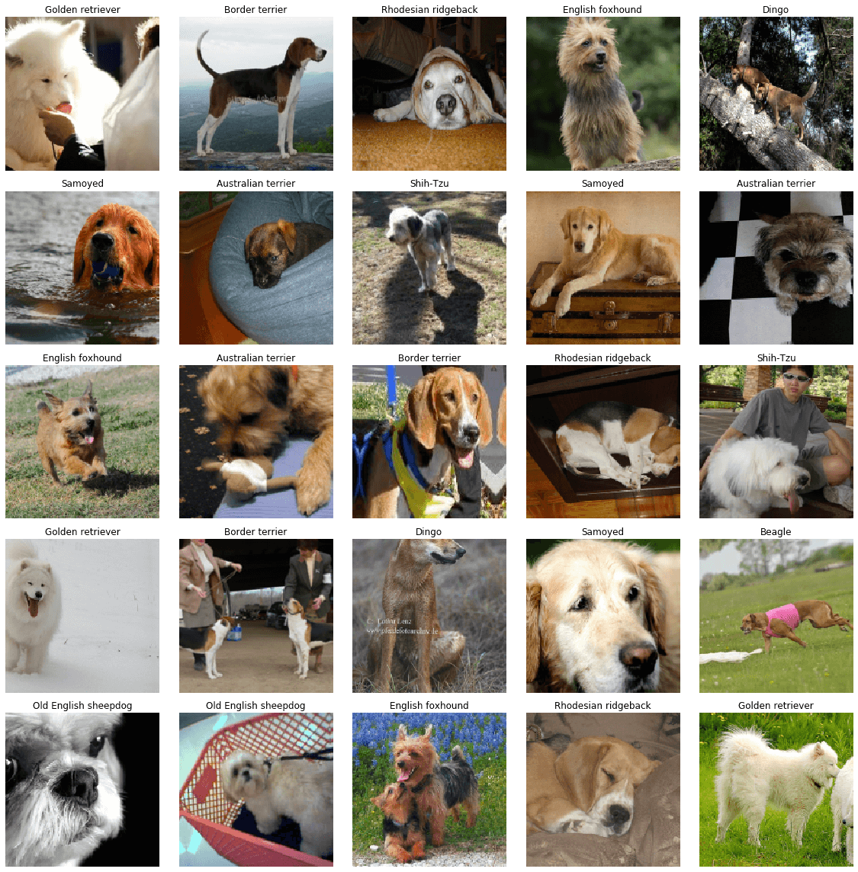
Recourses Used
Programming Language: Python
Machine Learning Libraries: TensorFlow, PyTorch
Image Processing: OpenCV
Data Handling: Pandas
Visualization: Matplotlib, Seaborn
Datasets: Kaggle Datasets
Model Evaluation: Scikit-learn
IDE: Jupyter Notebook, PyCharm
Version Control: Git, GitHub

Slide 5
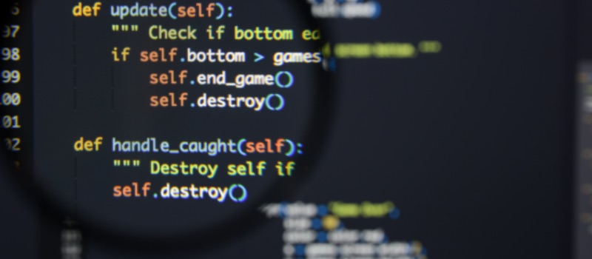
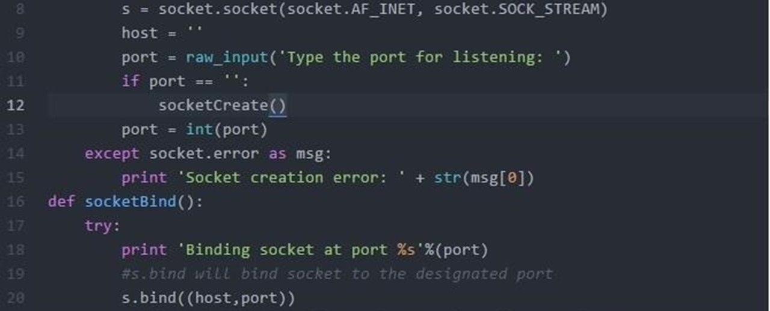
1. NAMISH RATHY -
PROJECT PLANNING (IDEATION)
CODE DESIGN
2. ARYAN MANCHANDA -
CODE DESIGN
GUI DESIGN
3. Manan Sharma-
DATABASE MANAGEMENT
CODE DESIGN
Team Details and Work Distribution

Slide 6

Thank You

